Slide 1

CS244a: An Introduction to Computer Networks
Handout 5: Internetworking and Routing
Nick McKeown
Professor of Electrical Engineering
and Computer Science, Stanford University
nickm@stanford.edu
http://www.stanford.edu/~nickm
Thanks for material: Aditya Akella, Peter Danzig

Slide 2
Outline
Techniques
  Naïve: Flooding
  Distance vector: Distributed Bellman Ford Algorithm
  Link state: Dijkstra’s Shortest Path First-based Algorithm
Routing in the Internet
  Hierarchy and Autonomous Systems
  Interior Routing Protocols: RIP, OSPF
  Exterior Routing Protocol: BGP
Multicast Routing
Routing is a very complex subject, and has many aspects.
Here, we will concentrate on the basics.

Slide 3

The Problem
“A”
“B”
R₂
R₁
R₄
How does R₁ choose a next-hop on the path towards host B?
R₃

Slide 4
Routing Metrics
Metrics
  Delay to send an average size packet (Make high speed links attractive, but closeness counts)
  Bandwidth
  Link utilization
  Stability: Is a link (or path) up or down?
Today: about 1/3 of Internet routes are asymmetric

Slide 5
Example network
Objective: Determine the route from A to B
that minimizes the path cost.
Examples of link cost:
Distance, data rate, price, congestion/delay, …
A
R₁
1
R₂
1
R₄
4
R₆
2
2
3
2
R₇
3
R₅
2
R₃
4
R₈
B

Slide 6
Example network
In this simple case, solution is clear from inspection
A
R₁
1
R₂
1
R₄
4
R₆
2
2
3
2
R₇
3
R₅
2
R₃
4
R₈
B

Slide 7
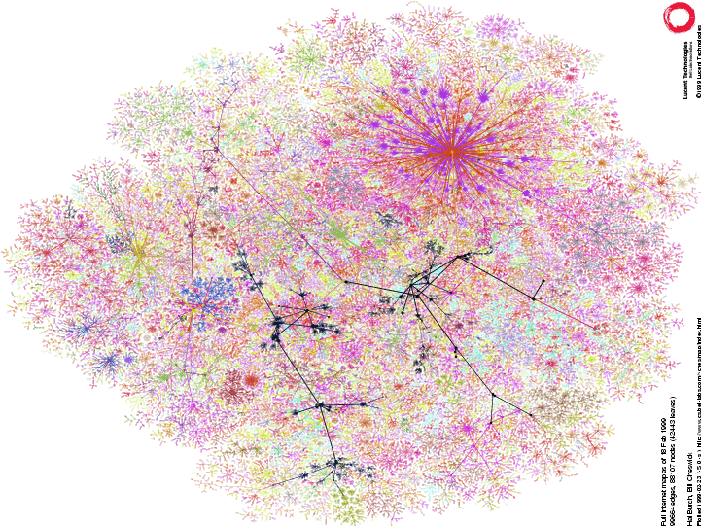
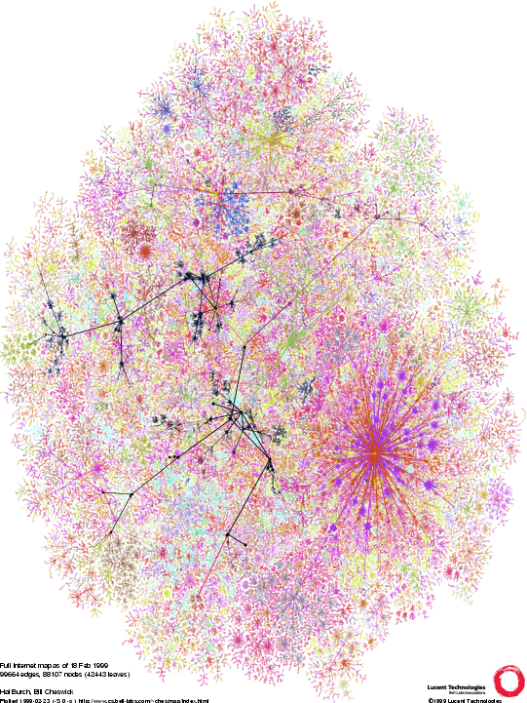
So what about this network...!?
The public Internet in 1999
Learn more at
http://www.lumeta.com

Slide 8
Technique 1: Naïve Approach
Flood! -- Routers forward packets to all ports
except the ingress port.
R₁
Advantages:
  Simple.
  Every destination in the network is reachable.
Disadvantages:
  Some routers receive a packet multiple times.
  Packets can go round in loops forever.
  Inefficient.

Slide 9
Spanning Trees
Objective: Find the lowest cost route from each of
(R₁, …, R₇) to R₈.
R₁
1
R₂
1
R₄
4
R₆
2
2
3
2
R₇
3
R₅
2
R₃
4
R₈

Slide 10
A Spanning Tree
R₁
1
1
4
R₂
R₄
R₆
3
2
2
R₇
2
R₅
2
3
R₃
4
R₈
The solution is a spanning tree with R₈ as the root of the tree.
Tree: There are no loops.
Spanning: All nodes included.
We’ll see two algorithms that build spanning trees automatically:
  The distributed Bellman-Ford algorithm
  Dijkstra’s shortest path first algorithm

Slide 11
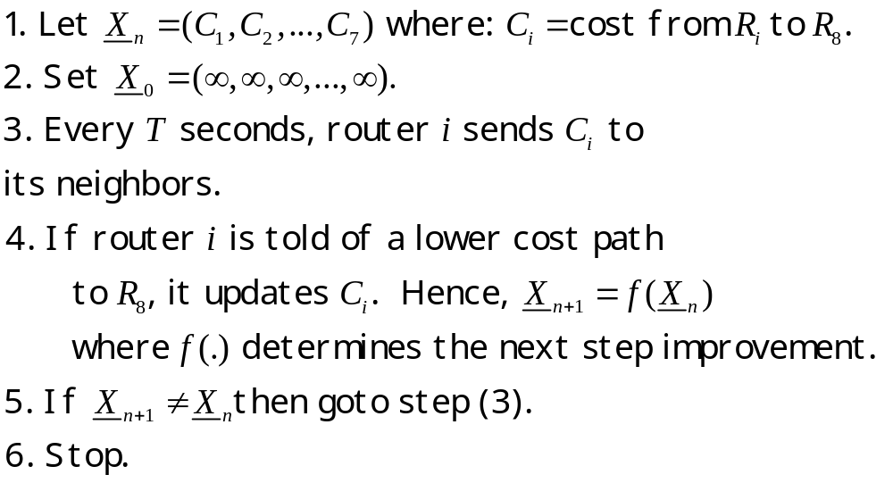
Technique 2: Distance Vector
The Distributed Bellman-Ford Algorithm
, for all i, to
This is the “Distance vector”.

Slide 12

Bellman-Ford Algorithm
Example
R₁
1
R₂
1
R₄
4
R₆
2
2
3
2
R₇
3
R₅
2
R₃
4
R₈
R₁ | Inf
R₂ | Inf
R₃ | 4, R₈
R₄ | Inf
R₅ | 2, R₈
R₆ | 2, R₈
R₇ | 3, R₈
4
2
R₁
1
R₂
1
R₄
R₆
3
2
3
2
2
2
R₇
4
R₅
2
3
R₃
4
R₈

Slide 13
Bellman-Ford Algorithm
R₁ | 6, R₃
R₂ | 4, R₅
R₃ | 4, R₈
R₄ | 6, R₇
R₅ | 2, R₈
R₆ | 2, R₈
R₇ | 3, R₈
6 4 6 2
R₁
1
R₂
1
R₄
4
R₆
3
2
3
2
2
2
R₇
3
4
R₅
2
R₃
4
R₈
Solution
R₁ | 5, R₂
R₂ | 4, R₅
R₃ | 4, R₈
R₄ | 5, R₂
R₅ | 2, R₈
R₆ | 2, R₈
R₇ | 3, R₈
5 4 5 2
R₁
1
R₂
1
R₄
R₆
2
3
2
2
4
R₇
3
R₅
2
R₃
R₈
4

Slide 14
Bellman-Ford Algorithm
Questions:
How long can the algorithm take to run?
How do we know that the algorithm always converges?
What happens when link costs change, or when routers/links fail?

Slide 15
A Problem with Bellman-Ford
“Bad news travels slowly”
R₁
1
R₂
1
R₃
1
R₄
Consider the calculation of distances to R₄:
Time
R₁
R₂
R₃
0
3,R₂
2,R₃
1, R₄
R₃ R₄ fails
1
3,R₂
2,R₃
3,R₂
2
3,R₂
4,R₃
3,R₂
3
5,R₂
4,R₃
5,R₂
…
…
…
…
“Counting to infinity”

Slide 16
Counting to Infinity Problem
Solutions
Set infinity = “some small integer” (e.g. 16). Stop when count = 16.
Split Horizon: Because R₂ received lowest cost path from R₃, it does not advertise cost to R₃
Split-horizon with poison reverse: R₂ advertises infinity to R₃
There are many problems with (and fixes for) the Bellman-Ford algorithm.

Slide 17
Example: Link failure with split horizon
A
3
4
4
R₁
R₃
R₂
4
2
3
R₄
R₅
4
2
B

Slide 18
A | 0, A
R₁ | 3, A
R₂ | 4, A
R₃ | 4, A
R₄ | 6, R₂
R₅ | 7, R₃
B | 9, R₅
A | 0, A
R₁ | 3, A
R₂ | 4, A
R₃ | inf, A
R₄ | 6, R₂
R₅ | 7, R₃
B | 9, R₅
A | 0, A
R₁ | 3, A
R₂ | 4, A
R₃ | inf
R₄ | 6, R₂
R₅ | inf,
B | 9, R₅
A | 0, A
R₁ | 3, A
R₂ | 4, A
R₃ | inf
R₄ | 6, R₂
R₅ | inf,
B | inf
A
3
4
4
R₁
R₃
R₂
4
A | 0, A
R₁ | 3, A
R₂ | 4, A
R₃ | inf
 | 6, R₂
R₅ | inf
B | 10,R₄
A | 0, A
R₁ | 3, A
R₂ | 4, A
R₃ | inf, A
R₄ | 6, R₂
R₅ | 12, B
B | 10,R₄
A | 0, A
R₁ | 3, A
R₂ | 4, A
R₃ | 15, R₅
R₄ | 6, R₂
R₅ | 12, B
B | 9, R₅
2
3
R₄
R₅
4
2
B

Slide 19
Technique 3: Link State
Dijkstra’s Shortest Path First Algorithm
Routers send out update messages whenever the state of an incident link changes.
  Called “Link State Updates”
Based on all link state updates received each router calculates lowest cost path to all others, starting from itself.
  Use Dijkstra’s single-source shortest path algorithm
  Assume all updates are consistent
At each step of the algorithm, router adds the next shortest (i.e. lowest-cost) path to the tree.
Finds spanning tree rooted at the router.

Slide 20
Reliable Flooding of LSP
The Link State Packet:
  The ID of the router that created the LSP
  List of directly connected neighbors, and cost
  Sequence number
  TTL
Reliable Flooding
  Resend LSP over all links other than incident link, if the sequence number is newer. Otherwise drop it.
Link State Detection:
  Link layer failure
  Loss of “hello” packets

Slide 21
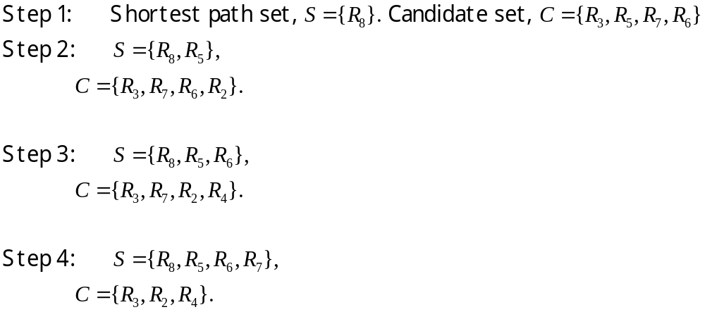
Dijkstra’s Shortest Path First Algorithm
Example
R₅
R₈
R₆
R₅
R₈
R₆
R₇
R₅
R₈

Slide 22
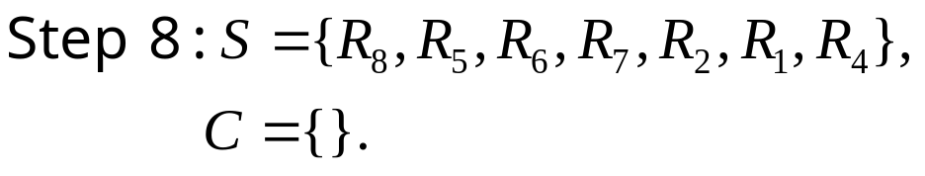
Dijkstra’s SPF Algorithm
R₁
1
R₂
1
R₄
R₆
2
R₇
R₅
3
2
R₈
R₃
4

Slide 23
Distance Vector vs Link State
Messages
  Size: small with LS; potentially large with DV
  Exchange: LS → flood!; DV →only to neighbors
Space requirements
  LS maintains entire topology
  DV maintains only neighbor state
Robustness:
  LS can broadcast incorrect/corrupted LSP
    Can be made robust since sources are aware of alternate paths
  DV can advertise incorrect paths to all destinations
    Incorrect calculation can spread to entire network
Examples (coming up later):
  LS: OSPF
  DV: RIP, RIP2

Slide 24
Outline
Techniques
  Flooding
  Distributed Bellman Ford Algorithm
  Dijkstra’s Shortest Path First Algorithm
Routing in the Internet
  Hierarchy and Autonomous Systems
  Interior Routing Protocols: RIP, OSPF
  Exterior Routing Protocol: BGP
Multicast Routing

Slide 25
Routing in the Internet
The Internet uses hierarchical routing
The Internet is split into Autonomous Systems (AS’s)
  Examples of AS’s: Stanford (32), HP (71), MCI Worldcom (17373)
  Try: whois –h whois.arin.net ASN “MCI Worldcom”
Within an AS, the administrator chooses an Interior Gateway Protocol (IGP)
  Examples of IGPs: RIP (rfc 1058), OSPF (rfc 1247).
Between AS’s, the Internet uses an Exterior Gateway Protocol
  AS’s today use the Border Gateway Protocol, BGP-4 (rfc 1771)

Slide 26
Routing in the Internet
AS ‘A’
AS ‘B’
AS ‘C’
BGP
BGP
Interior Gateway
Protocol
Interior Gateway
Protocol
Interior Gateway
Protocol
Stub AS
Transit AS
e.g. backbone service provider
Stub AS

Slide 27
Routing within a Stub AS
There is only one exit point, so routers within the AS can use default routing.
  Each router knows all Network IDs within AS.
  Packets destined to another AS are sent to the default router.
  Default router is the border gateway to the next AS.
Routing tables in Stub AS’s tend to be small.

Slide 28
Interior Routing Protocols
RIP
  Uses distance vector (distributed Bellman-Ford algorithm).
  Updates sent every 30 seconds.
  No authentication.
  Originally in BSD UNIX.
  Widely used for many years; not used much anymore.
OSPF
  Link-state updates sent (using flooding) as and when required.
  Every router runs Dijkstra’s algorithm.
  Authenticated updates.
  Autonomous system may be partitioned into “areas”.
  Widely used.

Slide 29
Exterior Routing Protocols
Problems:
  Topology: The Internet is a complex mesh of different AS’s with very little structure.
  Autonomy of AS’s: Each AS defines link costs in different ways, so not possible to find lowest cost paths.
  Trust: Some AS’s can’t trust others to advertise good routes (e.g. two competing backbone providers), or to protect the privacy of their traffic (e.g. two warring nations).
  Policies: Different AS’s have different objectives (e.g. route over fewest hops; use one provider rather than another).

Slide 30
Border Gateway Protocol (BGP-4)
BGP is not a link-state or distance-vector routing protocol.
  Instead, BGP uses “Path vector”
BGP advertises complete paths (a list of AS’s).
  Also called AS_PATH (this is the path vector)
  Example of path advertisement:
  “The network 171.64/16 can be reached via the path {AS1, AS5, AS13}”.
Paths with loops are detected locally and ignored.
Local policies pick the preferred path among options.
When a link/router fails, the path is “withdrawn”.

Slide 31

Customers and Providers
provider
provider
customer
IP traffic
customer
Customer pays provider for access to the Internet
Customer may not always need BGP

Slide 32
Customer-Provider Hierarchy
provider
customer
IP traffic

Slide 33
The Peering Relationship
peer
peer
Peers provide transit between
their respective customers
Peers do not provide transit
between peers
Peers (often) do not exchange $$$
provider
customer
traffic
allowed
traffic NOT
allowed

Slide 34
BGP Messages
Open : Establish a BGP session.
Keep Alive : Handshake at regular intervals.
Notification : Shuts down a peering session.
Update : Announcing new routes or withdrawing previously announced routes.
Attributes include: Next hop, AS Path, local preference, Multi-exit discriminator, …
  Used to select among multiple options for paths
BGP announcement = prefix + path attributes

Slide 35
BGP Route Selection Summary
Enforce relationships
E.g. prefer customer routes
over peer routes
Highest Local Preference
Shortest ASPATH
Lowest MED
i-BGP < e-BGP
traffic engineering
Lowest IGP cost
to BGP egress
Lowest router ID
Throw up hands and
break ties

Slide 36
ASPATH Attribute
AS 1129
135.207.0.0/16
AS Path = 1755 1239 7018 6341
Global Access
AS 1755
135.207.0.0/16
AS Path = 1239 7018 6341
135.207.0.0/16
AS Path = 1129 1755 1239 7018 6341
Ebone
AS 12654
AS 1239
135.207.0.0/16
AS Path = 7018 6341
Pick shorter
AS path
RIPE NCC
RIS project
Sprint
AS 7018
135.207.0.0/16
AS Path = 3549 7018 6341
135.207.0.0/16
AS Path = 6341
AT&T
AS 6341
AS 3549
135.207.0.0/16
AS Path = 7018 6341
AT&T Research
Global Crossing
135.207.0.0/16
Prefix Originated

Slide 37
So Many Choices…
peer
peer
AS 4
provider
customer
Frank’s
Internet Barn
AS 3
AS 2
Which route should
Frank pick to 13.13.0.0./16?
AS 1
13.13.0.0/16

Slide 38
Frank’s Choices…
Route learned from customer preferred over
route learned from peer, preferred over
route learned from provider
peer
peer
AS 4
provider
customer
local pref = 80
AS 3
local pref = 90
local pref = 100
Set appropriate “local pref”
to reflect preferences:
Higher Local preference values
are preferred
AS 2
AS 1
13.13.0.0/16

Slide 39
Traceroute with ASNs
TTL LFT trace to 216.35.221.77:80/tcp 1
[AS7011] [ELI-NETWORK-ELIX] eli-gw.home.mainnerve.net (65.73.254.1) 20.2ms 2
[AS5650] [ELI-NETBLK98] 209.210.114.245 20.2ms 3
[AS5650] [ELI-NETBLK99] s3-1-0--136.gw01.phnx.eli.net (216.190.111.161) 20.3ms 4
[AS5650] [ELI-2-NETBLK99] srp2-0.cr01.phnx.eli.net (208.186.20.118) 20.3ms 5
[AS5650] [ELI-NETBLK5] p6-0.cr01.lsan.eli.net (207.173.114.29) 40.3ms 6
[AS5650] [ELI-NETBLK5] p9-0.cr02.sntd.eli.net (207.173.114.54) 40.3ms 7
[AS5650] [ELI-2-NETBLK99] srp3-0.cr01.sntd.eli.net (208.186.21.33) 40.3ms 8
[AS5650] [ELI-NETBLK5] so-0-0-0--0.er01.plal.eli.net (207.173.114.138) 40.3ms 9
[AS5650] [SAVVIS] bpr2-ge-5-3-0.paloaltopaix.savvis.net (206.24.241.229) 40.2ms 10
[ASN?] [SAVVIS] dcr2-so-3-3-0.sanfranciscosfo.savvis.net (208.172.147.93) 40.3ms 11
[ASN?] [SAVVIS] dcr1-loopback.washington.savvis.net (206.24.226.99) 100.4ms 12
[ASN?] [SAVVIS] bhr1-pos-10-0.sterlingdc2.savvis.net (206.24.227.106) 100.5ms 13
[ASN?] [SAVVIS] csr1-ve240.sterlingdc2.savvis.net (216.33.96.58) 100.5ms
[neglected] no reply packets received from TTL 14 15
[ASN?] [SAVVIS] [target] 216.35.221.77:80 100.5ms

Slide 40
Who owns an address block?
prompt> whois 216.35.221.77
  OrgName: Savvis
  OrgID: SAVVI-2
  Address: 3300 Regency Parkway
  City: Cary
  StateProv: NC
  PostalCode: 27511
  Country: US
  ReferralServer: rwhois://rwhois.exodus.net:4321/
  NetRange: 216.32.0.0 - 216.35.255.255
  CIDR: 216.32.0.0/14
  NetName: SAVVIS
  NetHandle: NET-216-32-0-0-1
  Parent: NET-216-0-0-0-0
  NetType: Direct Allocation
  NameServer: DNS01.SAVVIS.NET
  NameServer: DNS02.SAVVIS.NET
  NameServer: DNS03.SAVVIS.NET
  NameServer: DNS04.SAVVIS.NET
  Comment:
  RegDate: 1998-07-30
  Updated: 2004-10-07
  # ARIN WHOIS database, last updated 2005-01-17 19:10
  # Enter ? for additional hints on searching ARIN's WHOIS database.

Slide 41



Organizations
Prompt> whois SU-NET
  OrgName: Stanford University
  OrgID: STANFO
  Address: Pine Hall 115
  City: Stanford
  StateProv: CA
  PostalCode: 94305
  Country: US
  NetRange: 128.12.0.0 - 128.12.255.255
  CIDR: 128.12.0.0/16
  NetName: SU-NET
  NetHandle: NET-128-12-0-0-1
  Parent: NET-128-0-0-0-0
  NetType: Direct Assignment
  NameServer: ARGUS.STANFORD.EDU
  NameServer: AVALLONE.STANFORD.EDU
  NameServer: ATALANTE.STANFORD.EDU
  Comment:
  RegDate:
  Updated: 2000-05-01
  TechHandle: JK535-ARIN
  TechName: Kohn, Jay
  TechPhone: +1-650-723-7515
  TechEmail: security@stanford.edu
  # ARIN WHOIS database, last updated 2005-01-17 19:10
To receive AS from a particular route arbiter: Whois –h whois.ra.net 128.125.0.0
North American AS Numbers and Addresses
DNS Top level domains and delegates IP Address blocks

Slide 42
Multicast Routing
Applications that benefit from multicast.
Trees, addressing and forwarding.
Multicast routing
  Distance Vector-based (DVMRP, PIM-DM)
  Link-state based (MOSPF)
  Rendezvous-based (PIM-SM, CBT)
Some interesting questions…

Slide 43
Multicast Trees
The basic idea
G
Server
G
Server
G
G
G
G
G
G
G
G
Multiple unicasts
Single multicast

Slide 44
Applications that need multicast
One way, single sender: “one-to-many”
  TV
  Non-interactive learning
  Database update
  Information dispersal (e.g. Pointcast)
  Software updates/patches
Two way, interactive, multiple sender: “many-to-many”
  Teleconference
  Interactive learning

Slide 45
Multicast Routing
A multicast tree is a spanning tree with the sender at the root, spanning all the members of the group.

Slide 46
Multicast Trees e.g. a teleconference
Sender/Speaker
Multicast Group (S₁,G)
S₁
S₁
Class
D
R

Slide 47
Multicast Trees and Addressing
All members of the group share the same “Class D” Group Address.
An end station may be the member of multiple groups.
An end-station “joins” a multicast group by (periodically) telling its nearest router that it wishes to join (uses IGMP – Internet Group Management Protocol).
Routers maintain “soft-state” indicating which end-stations have subscribed to which groups.

Slide 48
Multicast Trees
Multiple source trees
S₂
Class
D
R
S₂
Sender/Speaker
Multicast Group (S₂,G)

Slide 49
Multicast Forwarding is
Sender-specific
Group
Address
Src
Address
Src
Interface
Dst
Interface
G
S₁
1
2,3
S₂
2
1,3
R
S₁
G
2
1
3
1
2
S₂
G
3

Slide 50
Outline
Applications that need multicast.
Trees, addressing and forwarding.
Multicast routing
  Distance Vector-based: DVMRP, PIM-DM
  Link-state based: MOSPF
  Rendezvous-based: PIM-SM, CBT
Some interesting problems…

Slide 51
Distance-vector Multicast
RPB: Reverse-Path Broadcast
Uses existing unicast shortest path routing table.
  Computed using Distance vector
If packet arrived through interface that is the shortest path to the packet’s SA, then forward packet to all interfaces.
Else drop packet.

Slide 52
Distance-vector Multicast
RPB: Reverse-Path Broadcast
Address
Port
Sender/Speaker
Multicast Group (S₁,G)
Unicast
DV Routing
Table
S₁
S₁
1
1
3
2
LAN
Shortest Path to Source
Q: Is it shortest path from source?

Slide 53
Distance-vector Multicast
RPB: Reverse-Path Broadcast
Sender/Speaker
Multicast Group (S₁,G)
S₁
Designated Parent Router:
One parent router picked per LAN (one “closest” to source).
LAN

Slide 54
Distance-vector Multicast
RPM: Reverse-Path Multicast
RPM = RPB + Prune
RPB used when a source starts to send to a new group address.
Routers that are not interested in a group send prune messages up the tree towards source.
Prunes sent implicitly by not indicating interest in a group.
DVMRP works this way.

Slide 55
Protocol Independent Multicast
PIM-DM (Dense Mode) uses RPM.
PIM-SM (Sparse Mode) designed to be more efficient that DVMRP
  Key idea: use a rendezvous point (RP)
  Routers explicitly join multicast tree by sending unicast Join and Prune messages.
  Routers join a multicast tree via an RP for each group.
  Several RPs per domain (picked in a complex way).
  Provides either:
    Shared tree for all senders (default)
    Source-specific tree

Slide 56
PIM-SM
Unicast to R3: (S,G)
Source knows to send all G packets to RP.
RP unwraps mcast pkt and forwards to local tree.
Source “tunnels” mcast-in-ucast packets to RP.
RP
Unicast to RP: (*, G)
RP knows R1 has joined
R2 learns to send (*,G)
packets to R1
R2
S
R1
IGMP Join
Sender/Source

Slide 57
PIM-SM
Optional Source-specific join to bypass RP router:
Routers along the way learn new path for (S,G).
RP
R2
S
R1
Sender/Source

Slide 58
Outline
Applications that need multicast.
Trees, addressing and forwarding.
Multicast routing
  Distance Vector-based: DVMRP, PIM-DM
  Link-state based: MOSPF
  Rendezvous-based: PIM-SM, CBT
Some interesting problems…

Slide 59
Multicast: Interesting Questions
How to make multicast reliable?
How to implement flow-control?
How to support/provide different rates for different end users?
How to secure a multicast conversation?
Will multicast become widespread?
  Several protocols for multicast routing in IP
    But IP multicast is not enabled in routers!
    No one uses IP multicast, really
    End-system based, overlay-based approaches more popular

